Slide 1
Voronoi Tessellations in Augmented Reality

Slide 2
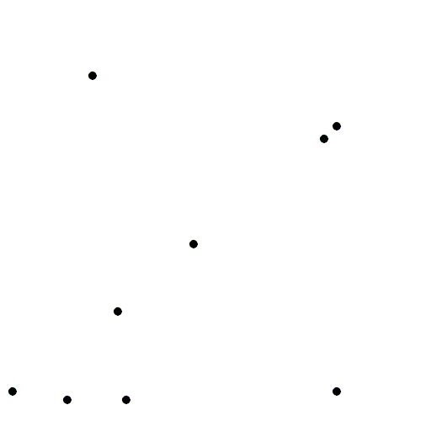
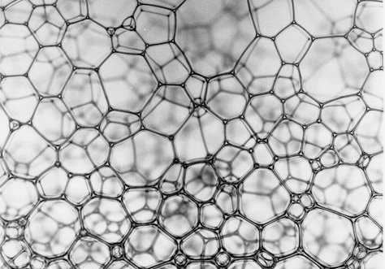
Context
Our Client, University of Bristol’s School of Mathematic, has requested an app that will allow for the Fry building’s Voronoi tessellation sculpture to be visualised in 3D.
A Voronoi tessellation is a diagram in n-dimensional Euclidean space which is divided into a set of areas in n-dimensions. A Voronoi diagram is built based upon a set of points in the space, known as the ‘seed’ or ‘generator’.
For each point x, there is exactly one corresponding area, which is defined by the set of all points closer to x than any other in the seed.
The example shown represents the diagrams in 2D space, where each point can be drawn, and then around each point a circle grows at the same rate, where the area of the space is coloured based on the first circle to reach each blank area.
Voronoi diagrams can be observed in bubbles closely packed together, which exhibit loosely similar behaviour to the growing circles example.
Translating a Voronoi diagram between dimensions is relatively simple, as for all euclidean diagrams, an n-1 dimensional ‘slice’ can be created when n > 2 by defining one dimensional value to be a constant and recording only the diagram at that point.

Slide 3
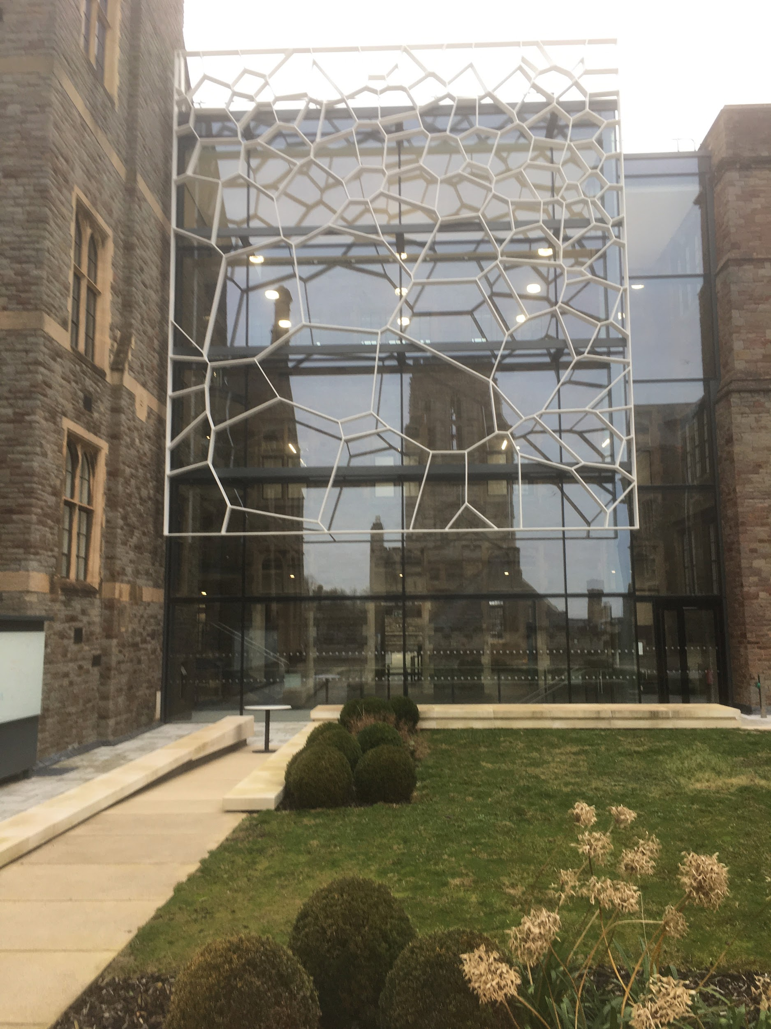
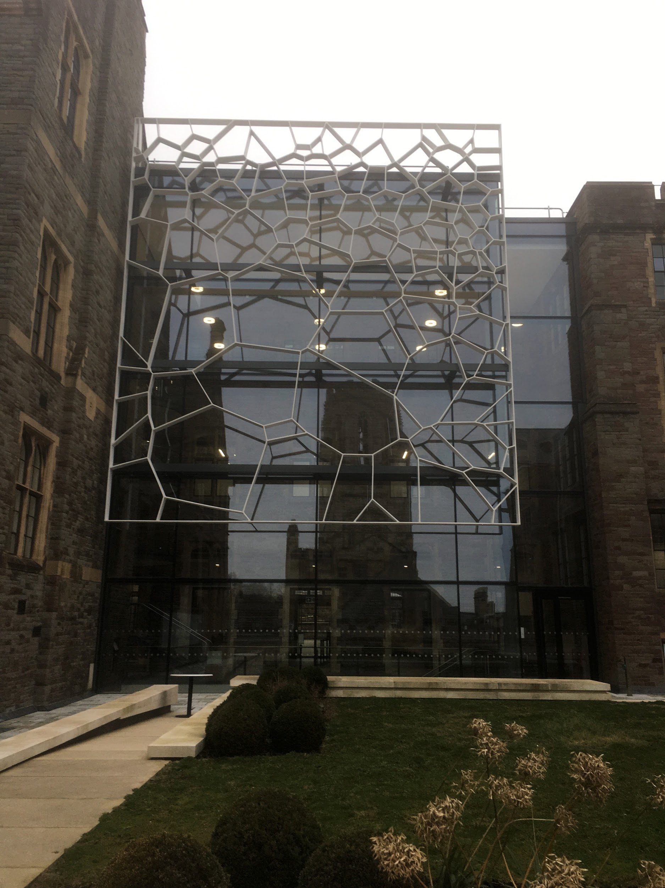
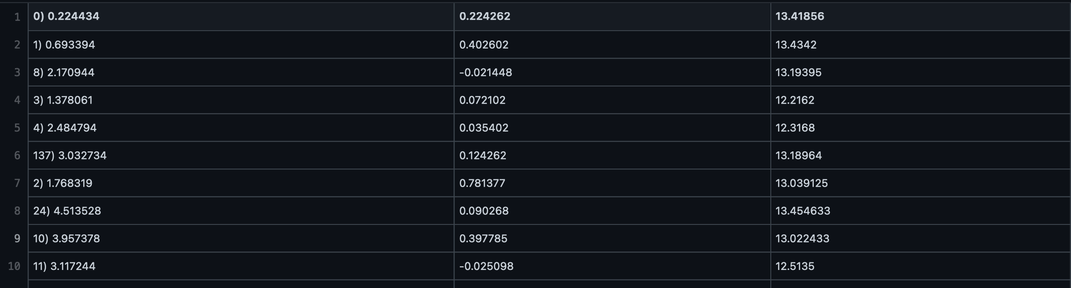
Opportunity/Problem
Our contact with our clients has been through Dr Marton Balazs and Professor Peter Green, who are with the math department, and supplied us with the information and briefing necessary for our project.
The Sculpture at the Fry building is a 2 dimensional slice of a 3 dimensional set of points, Professor Peter Green provided us with the seed for the 3 dimensional tessellation as a .csv file, which we have been tasked with using to produce an app that implements Augmented Reality to produce the 3rd dimension for the sculpture.
Our clients have allowed for a lot of flexibility with the design of the app, for example with making a welcome screen and how the UI will be designed, as well as a high level of creative freedom with how we wish for the diagram to be visualised, for example do we make the diagram translucent so the inner cells can be seen or should the app implement a slider to adjust how far from the existing sculpture the 3d model extrudes?
We were given a chance to visit the sculpture at the end of term last year; the sculpture is on the inside wall of the inner courtyard, placed as a facade over the glass wall.
The project’s application is for potential future students and other visitors to the University to be able to download/use the app as a demonstration of both projects in the Maths department and the Computer Science courses

Slide 4
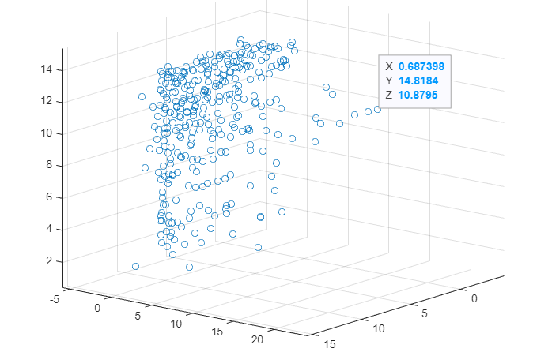

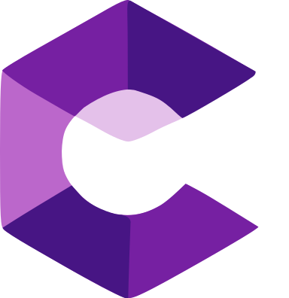


Solution
Important decisions:
-We will focus on Android
-We will use AR Core (technology made by Google a few years ago)
-We will model the tessellation in Blender where we can have more artistic control over it
-With Android Studio we will create an app that will combine everything together in an informative and efficient way
-Upon first visualising the points we decided to try and find a way to edit them while staying true to the original frame for artistic purposes.
- We will put up some QRcodes in very close proximity to the sculpture that will provide a link to download the app and calibrate it to the position of the user

Slide 5
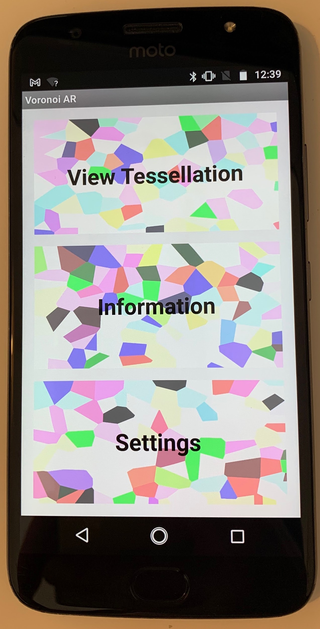
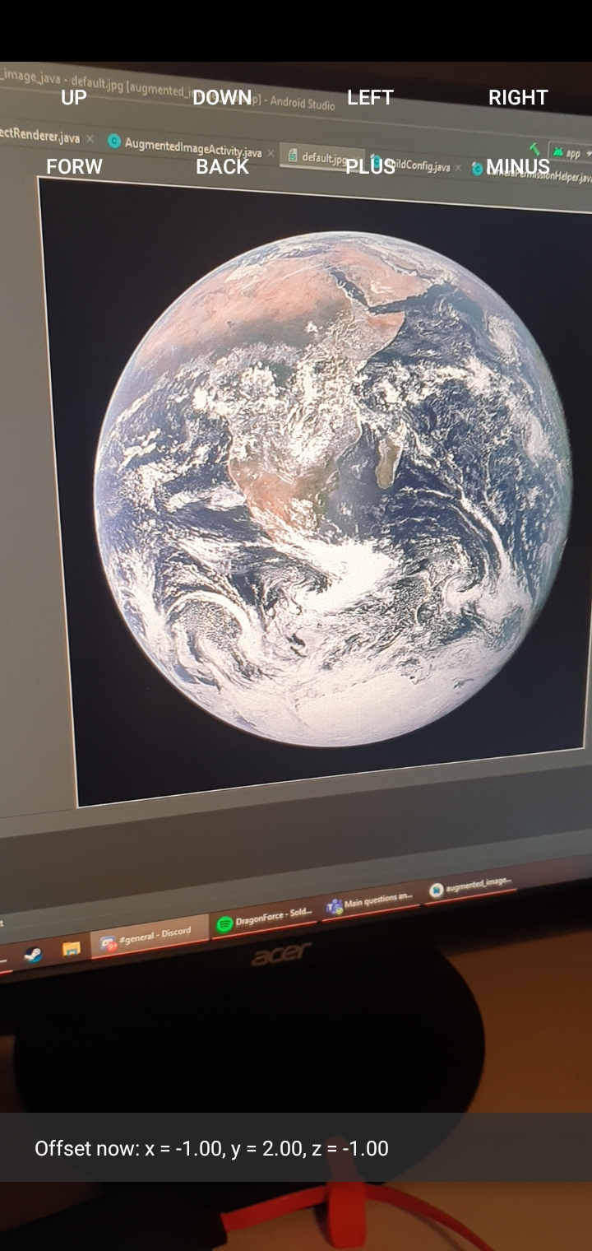
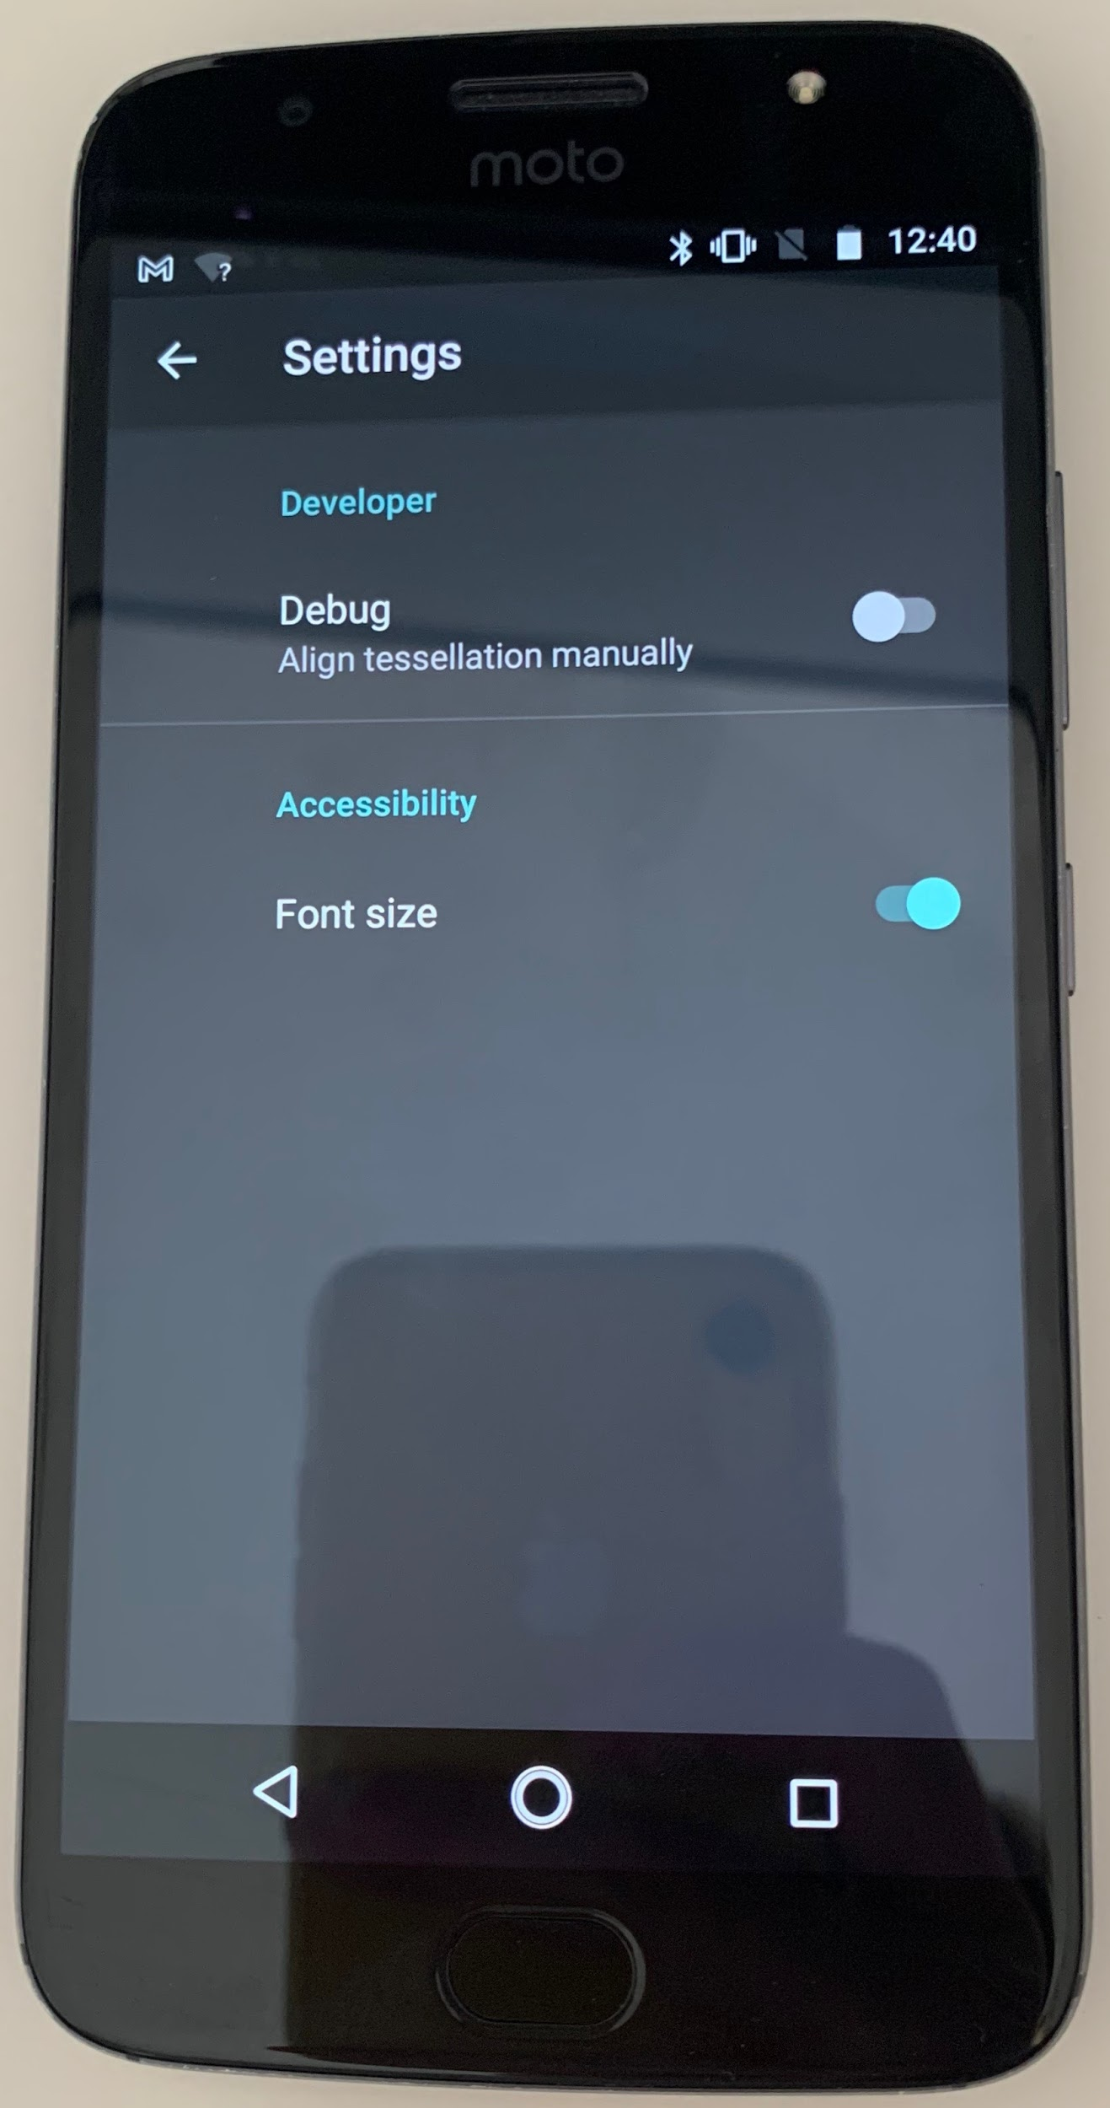
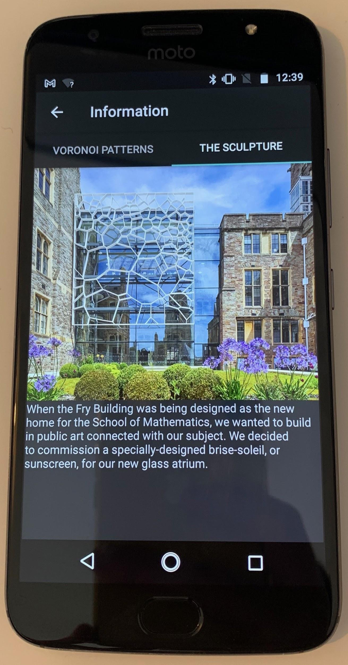
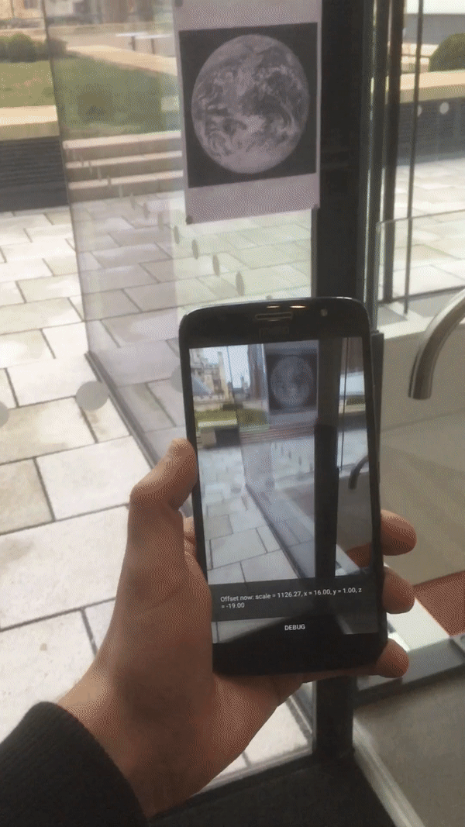
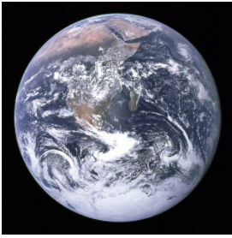
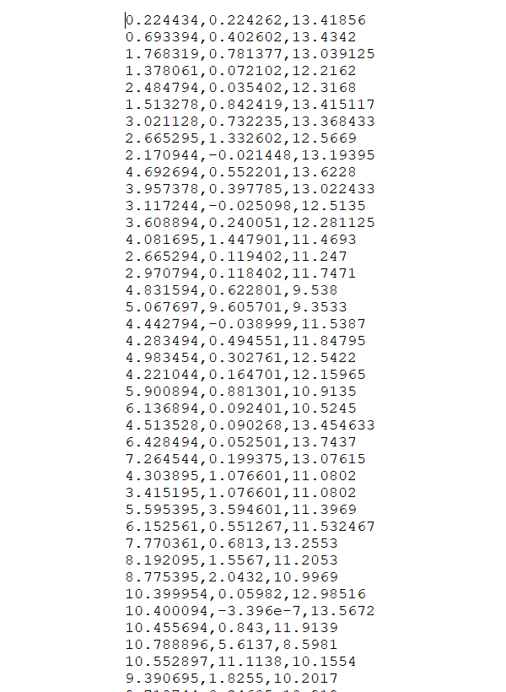
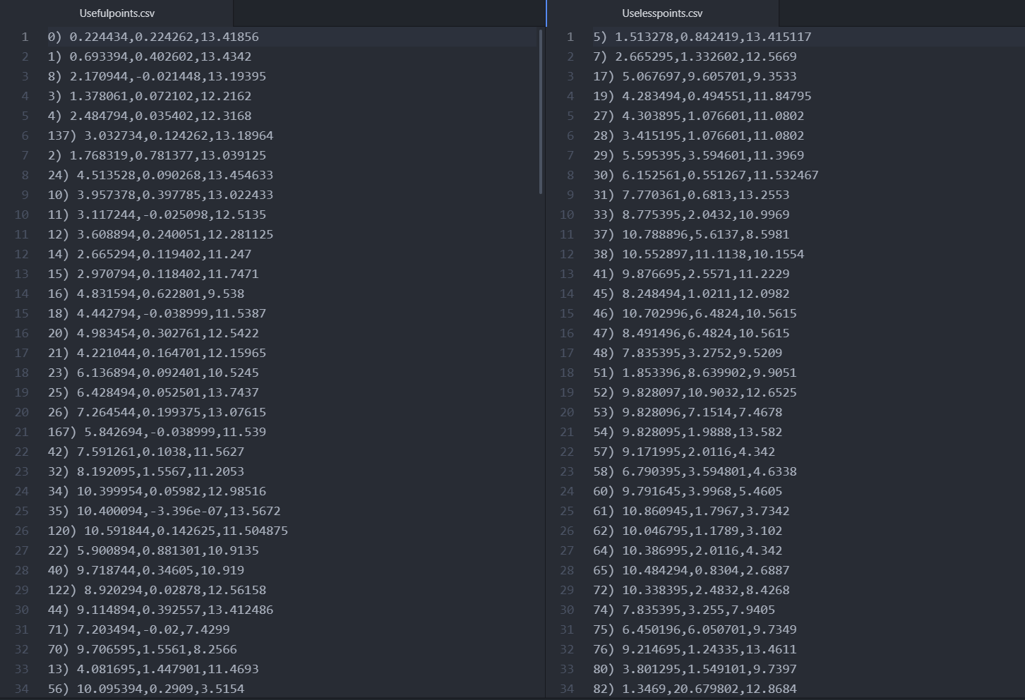
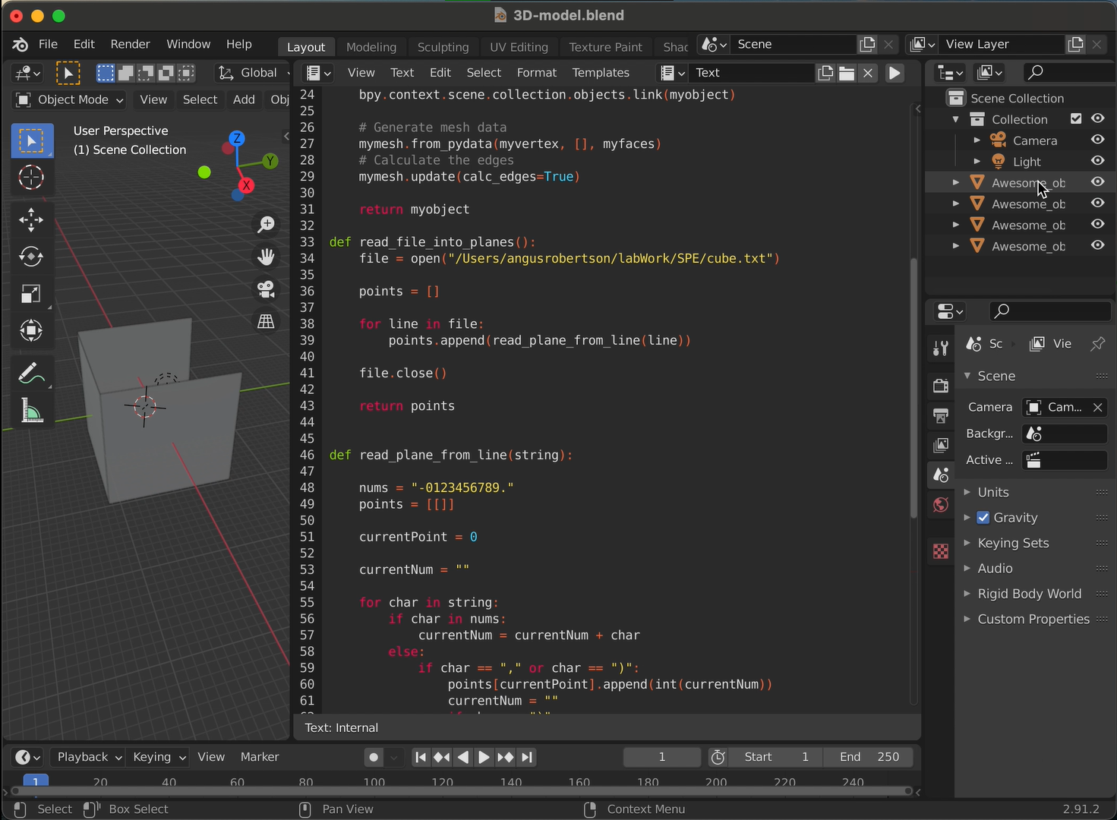
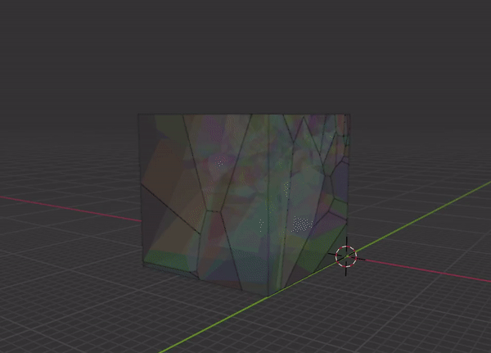
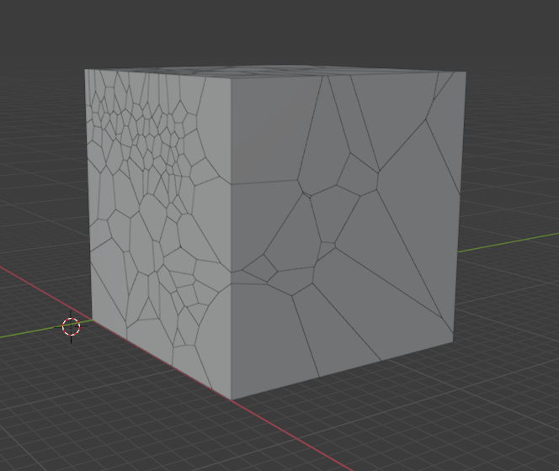
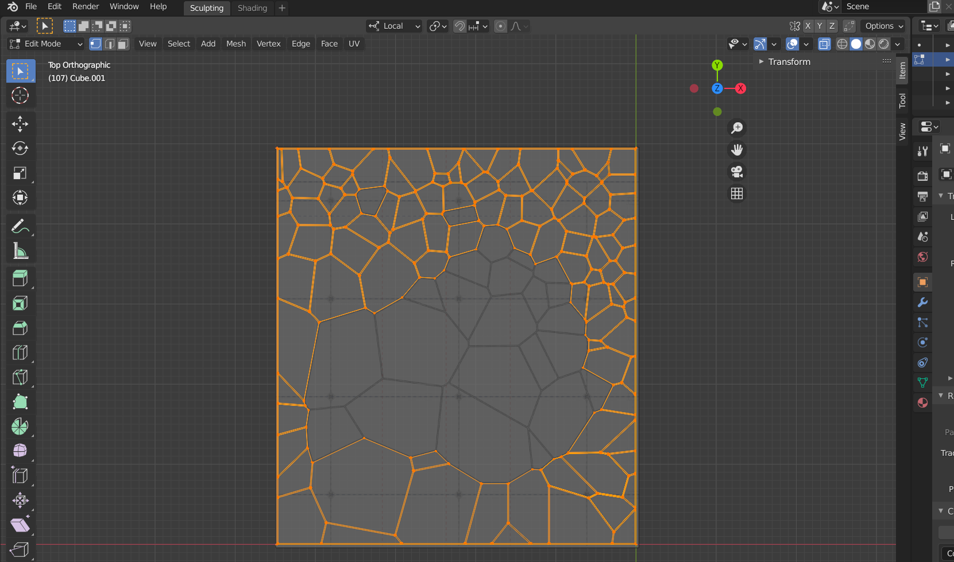
Current State
- We have plotted the points and made them into a 3D model we could finally use in AR Core
- We made a quick python script that separates the list of points in points we are not can not modify and those we can space out a bit
- We implemented an easy to use interface and a debug mode for our alpha version
- We have used a blender python api to render tessellation as a 3D model that we already have artistic contol over in the form of materials
- We are making a digital representation of the frame in Blender in order to have a functional test environment

Slide 6
Plan for rest of TB2
1 Beta Release
Integrate tessellation with app
Polish up placeholder pages
Client feedback
2 Small Updates for Additional Features
On-site testing and alignment
Model transparency/colour
Accessibility settings
3 Final Release
Deploy to Google Play store

Slide 7
Biggest Lessons Learnt
Starting is the hardest part
Teamwork
Technical skills

